Slide 1
C Code Comprehension
Name: A. M Samdani Mozumder
Roll: BSSE 1412
Supervisor Name: Dr. Kazi Muheymin-Us-Sakib

Slide 2
Table of Contents
01. Project Description
02. Motivation
03. Working Methodology
04. Technology
05. Progress
06. Further Plan
07. Challenges

Slide 3
Project Description
1

Slide 4
Project Description
This Software tool is designed for underdstanding C source code specially for beginners. This will take a C source code from the user. Then it will interpret line by line of the source code.
It will also help the user to find some common errors of the source code.

Slide 5
Motivation
2

Slide 6
Motivation
Static analysis is widely used in software engineering by software development and quality assurance teams. Software developers should use static code analysis for a better understanding of the software, code simplification and sanitizing, identifying potential bugs, coding standards, improving application performance, better resource utilization, etc.

Slide 7
Working Methodology
3

Slide 8
Working Methodology
Overview of Full Process
Interpretation
Read C File
Show result
Common Syntactical Errors

Slide 9
Working Methodology
Interpretation
Until line number is same of tokens that is one line of our source code and interpret that line using those tokens.
Source
Code
Preprocessing
Tokenization
Read Tokens

Slide 10
Technology
4

Slide 11
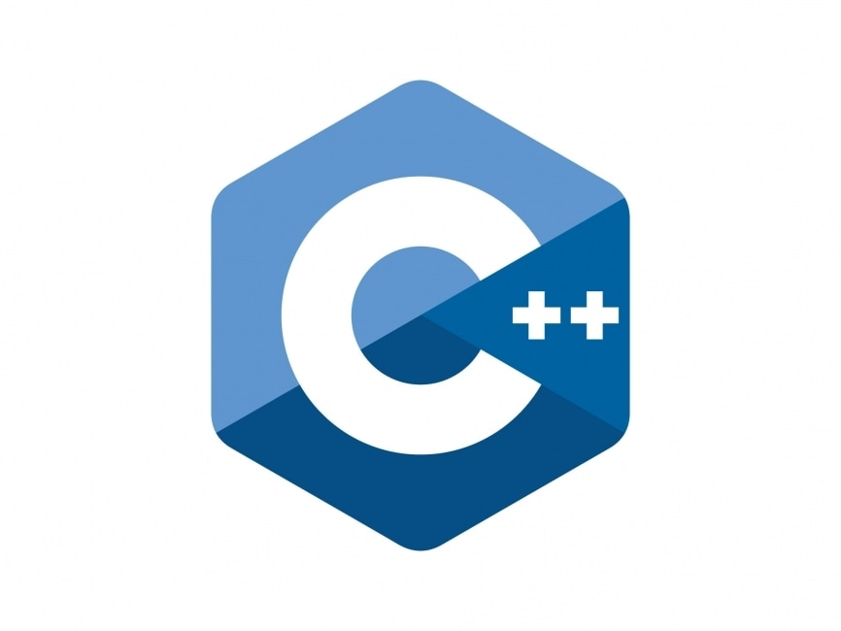
Technology

Slide 12
Progress
5

Slide 13
Progress
Interpretation
Tokenization
Reading Headers
Reading Main Function
Reading Variable Type
Reading Variable Value
Reading If statement
Reading Single Condition inside if
Reading Condition is either or not
Reading For loop and its three parts
Variable Declaration
Condition
Modification
Reading While loop
Reading Printf Statement
Line Of Code
1085

Slide 14
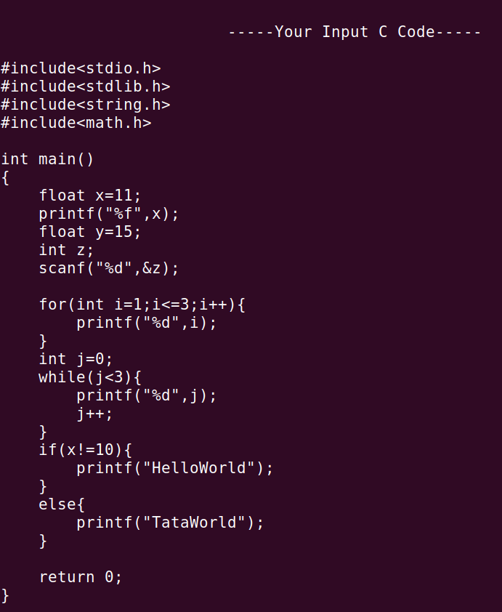
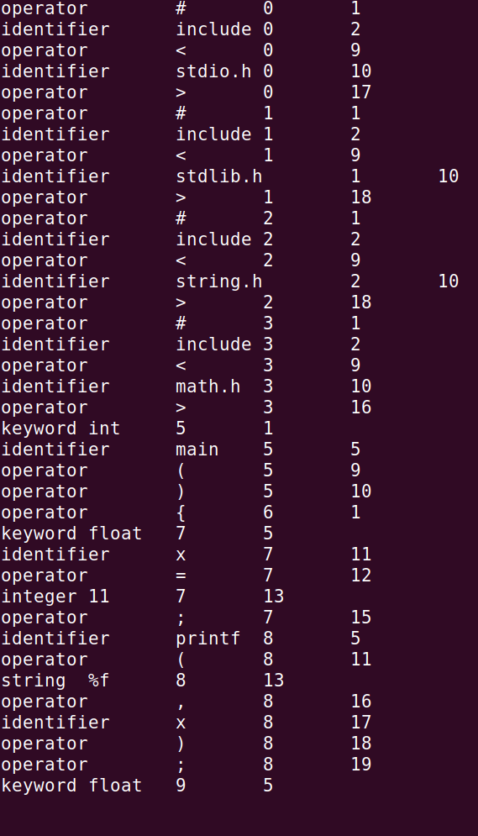
Tokenization

Slide 15
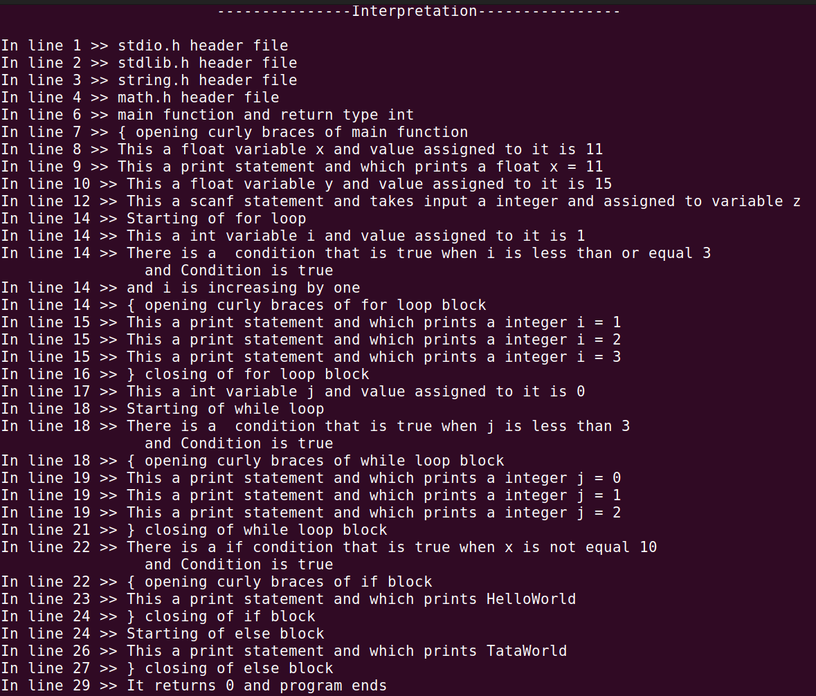

Slide 16
Further Plan
6

Slide 17
Further Plan
Interpretation
Reading Expression
Reading Arrays,String,Pointers
Try to introduce dynamic analysis also to interpret
Syntactical Errors
Semicolon error
Opening and Closing Brackets error

Slide 18
Challenges
7

Slide 19
Challenges
Challenges so far:
First time working on a big project
Tokenization of source code (Lexical Analysis)
File Manipulation and implementing Map Data structure
Further challenges:
Learning about grammer of finding Syntactical Erros
Learning about Dynamic Analysis and its implemention on interpretation

Slide 20
Thank You
GitHub repository: https://github.com/samdani91/SPL-1

